Slide 1
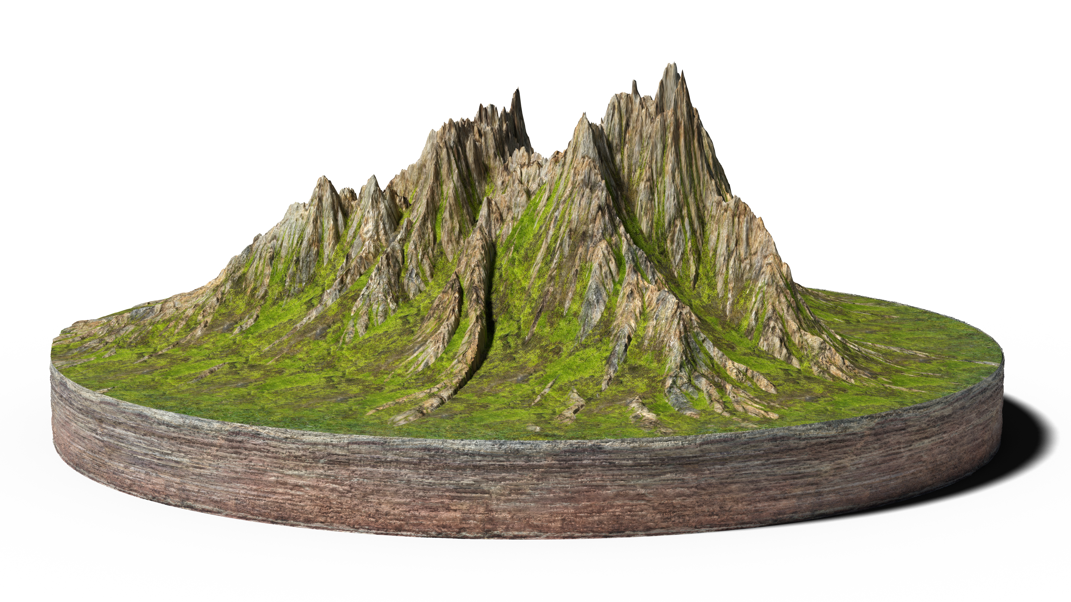
Lawyers Helping Lawyers
Using OUR Strengths
Building OUR Wellbeing
An exercise in Appreciative Inquiry

Slide 2
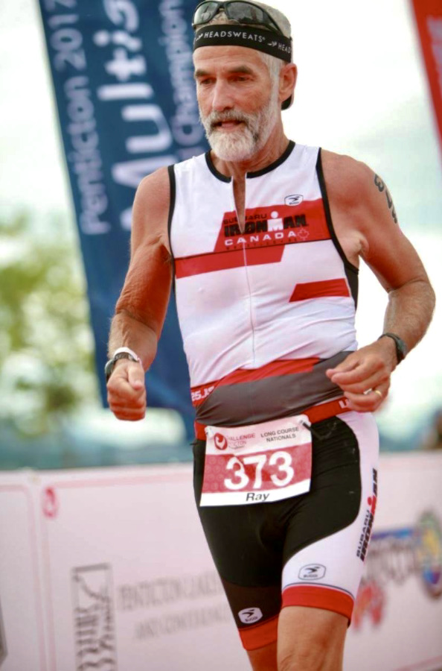
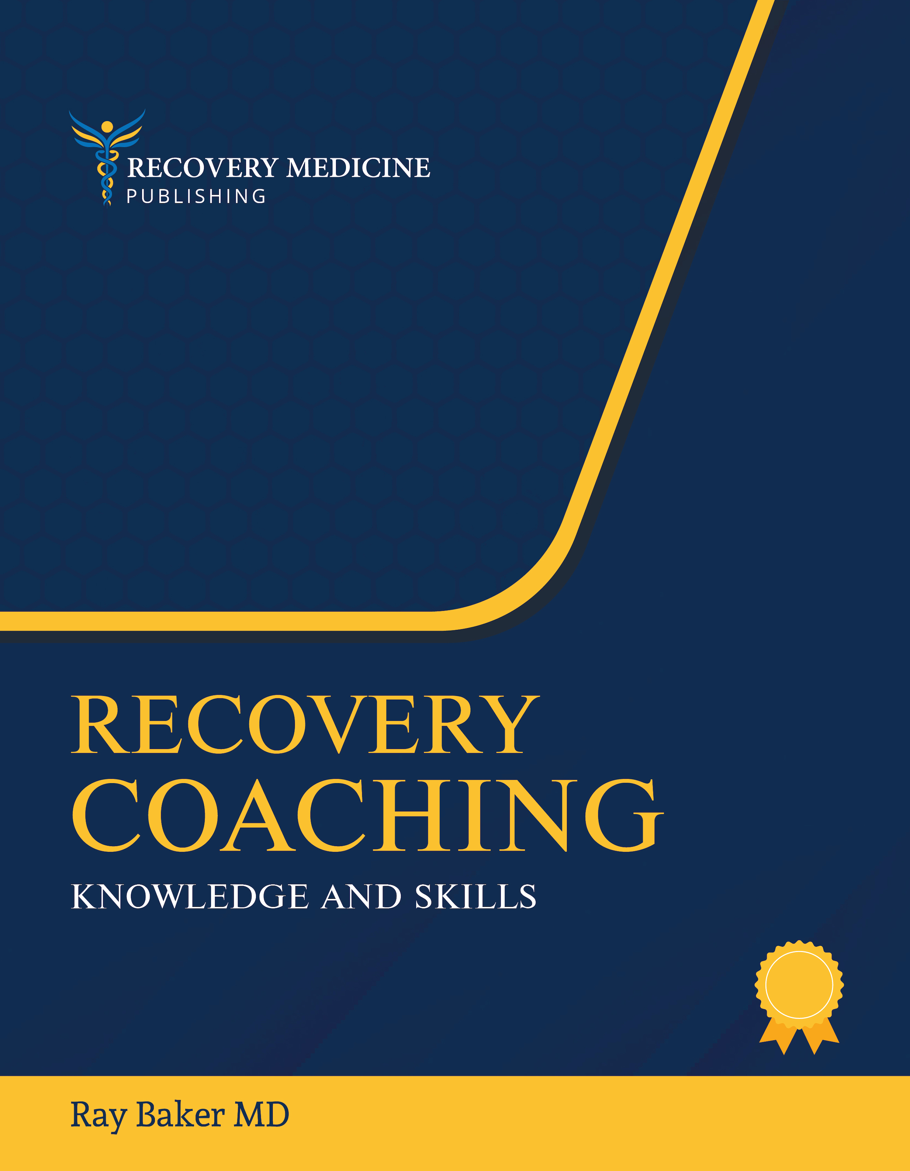
Your Facilitator
35 years addiction medicine
medical educator - UBC
2016 – transitioned from addiction medicine to recovery medicine
author: Recovery Coaching Knowledge & Skills
long-term addiction recovery

Slide 3
This Morning
Self introductions: learning our strengths
Wellbeing? – an overview/review
Alphabet soup of acronyms: CHIME, PERMA,
Positive psychology
Appreciative Inquiry
Building our community of wellbeing

Slide 4
Exercise
Quickly group yourselves, based upon your month of birth, into tables of 6 people
If your table already has 6, move to table on either side
Select a recorder
and a reporter
Table 1 | Jan – Feb - Mar
Table 2 | Mar - Apr - May
Table 3 | May – Jun - Jul
Table 4 | Jul - Aug - Sep
Table 5 | Sep - Oct - Nov
Table 6 | Nov - Dec - Jan

Slide 5
Interviews
Divide into pairs and take turns interviewing each other
Interviewer: approach the interview knowing that the interviewee has: 1. wonderful strengths 2. experienced success in using them 3. is capable of applying these amazing strengths to create novel solutions
Interviewers are preparing to introduce the interviewee to the rest of your table group, featuring their strengths
You will have 10 minutes for each interview before you are signaled to reverse roles

Slide 6
Introductions
Take turns (5 min. or so) introducing your interviewee telling your table group a bit about them, their experiences and strengths
During introductions the recorder lists key strengths of individuals and common trends or traits of the group
Come up with a theme, name, saying, logo, drawing, skit or a unique way to introduce your group to the larger audience of workshop participants

Slide 7
And now… the talk (a refreshing drink from the firehose)
Wellbeing – what is it?
Recovery – and its determinants (CHIME)
Positive Psychology and resilience (PERMA)
Diseases and disorders vs. health and wellbeing
The 4 D’s of Appreciative Inquiry

Slide 8
WellBeing
6-factor Psychosocial Model - C. Ryff
Self-acceptance
Personal growth
Purpose in life
Environmental mastery
Autonomy
Positive relations with others

Slide 9
WellBeing
Biopsychosocial Model
healthy environment (physical, social, cultural, and economic)
developmental competency (healthy identity, emotional and behavioural regulation, interpersonal skills, and problem-solving skills)
sense of belonging
healthy behaviours (sleep, nutrition, exercise, stress management, connections with others, avoidance of toxins)
resilience
treatment of medical/mental illness

Slide 10
Recovery?
“A process of change through which individuals improve their health and wellness, live a self-directed life, and strive to reach their full potential”
SAMHSA

Slide 11
CHIME Essential Conditions for Recovery (mental health and addiction) – M. Leamy 2011
z
Connection
Hope
Identity
Meaningfulness
Empowerment

Slide 12
Positive Psychology an Attitude Adjustment
Attitude: aviation term to describe 3-D orientation in space
Attitude + intention determine course
Focus on strengths and successes (think reverse engineering)
Placebo effectiveness: example of power of attitude + intention or belief

Slide 13
Positive Psychology
A scientific approach to human thoughts, feelings, and behaviors, focusing on strengths, building the good rather than repairing the bad. Improving lives of everyone instead of focusing solely on moving those who are struggling up to “normal”
(Peterson, 2008).

Slide 14
Positive Psychology
Focus on solutions rather than problems, strengths rather than weaknesses, what works rather than what needs fixing
Positive emotions & traits:
joy, inspiration, gratitude,
love, interest, serenity, hope,
awe, amusement, compassion, resilience
Practical applications:
appreciative Inquiry, motivational interviewing, coaching

Slide 15
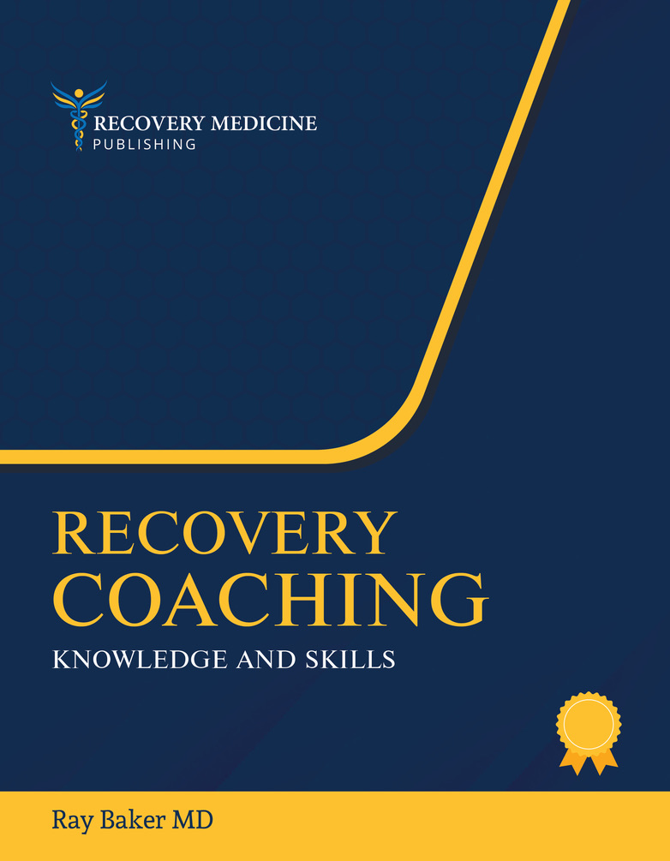
PERMA: the Roots of Resilience
Positive Emotions
Engagement (Flow)
Positive Relationships
Meaning
Achievement
Seligman: Flourish 2012

Slide 16
Community, Relationships, Recovery Capital, Strengths, Solutions, Agency/Autonomy, Connection, Hope, Identity, Meaning, Purpose, Exercise, Nutrition, Sleep, Stress Management, Wellbeing, Health, Positive Emotions, Altruism, Volunteering, Learning, Creativity, Spirituality, Engagement, Flow, Resilience
Recovery - Health
Depression
Disease - Disorderr
PTSD
Heart Disease
Cancer
Diabetes
Chronic Pain
Addiction

Slide 18
Epic Study (European Prospective Study into Cancer and Nutrition)
25,000 people counselled: regular exercise, non-smoking, weight reduction, switch to low meat diet, lots of fruits, veggies, grains. At 15 years – compared to control group:
78% decrease in chronic disease
93% reduced diabetes
81% reduced heart attack
50% reduced stroke
36% reduction all types of cancer
Ornish D. Undo It! Random House

Slide 19
Healthy Eating
Increase vegetables
Decrease animal protein and fats
Decrease refined carbs
Minimize bad fats (trans, saturated, hydrogenated)
Eat “good fats” (omega-3, medium chain fatty acids)
Organic is best

Slide 20
Exercise Benefits
25 min/day walking increases life 7 years
15 min/day cut women’s risk of heart attack/stroke in half
Becoming a runner (slow/fast/longer/shorter) live 3 years longer
Every hr. running adds 7 hrs life (up to max. 3 yrs)
Adults who walked 40 min/d showed hippocampus growth: improved cognition and memory

Slide 21
Stress is Bad:
Immune system depression: infection, cancer
Accelerated aging
Heart disease, autoinflammatory diseases, accidents, depression, suicide, dementia
Stress is Good:
Bone/muscle strength
Enhanced learning
Improved performance
Survival
Pleasure, mood elevation

Slide 22
“Lack of social connection
is more harmful to health
than obesity, smoking and high blood pressure”
House, Landis, Anderson, Science 29 Jul 1988: Vol. 241, Issue 4865, pp. 540-545

Slide 23
Lifestyle Health Recommendations
Exercise most days
Eat mostly plant-based food (low on food chain)
Avoid: excessive sweets, bad fats, junk food, toxins, trauma and too much sun
Pay attention, meditate/pray, practice optimism and gratitude
Stay connected with people – especially people who care

Slide 24
Discovery
What strengths do you bring?
2. Your success stories
Next…
Dream
Design

Slide 25
Exercise
Individually: consider the mix of strengths, experiences, expertise of your table group and think of a well-being idea, project, or activity to improve the health (well-being, recovery, happiness, satisfaction) of lawyers in your community
Be prepared to pitch your idea to your group. Work on your own, you’ll get a chance to work together later
15 minutes

Slide 26
Exercise
Take turns, in 5 minutes or less pitch your idea to your group
Recorders list ideas with short descriptions
When you’ve all had a turn, decide on the top 3 ideas
Make a little sign with each of the 3 ideas

Slide 27
Exercise
Convene the whole room
Reporters from each table will quickly describe their 3 idea/projects to the room and post them on the wall
Once all ideas are posted, everyone takes their sticky dots and votes using coloured dots for your #1, #2 and #3 choices

Slide 28
Summary
Your amazing strengths and stories
Wellbeing (health vs disease)
Positive psychology, appreciative inquiry
Working together building our wellbeing

